Slide 1
Arizona Department of Environmental Quality Mulit-Sector General Permit (2019)
Christopher Henninger, Supervisor
Surface Water Permit Unit

Slide 2
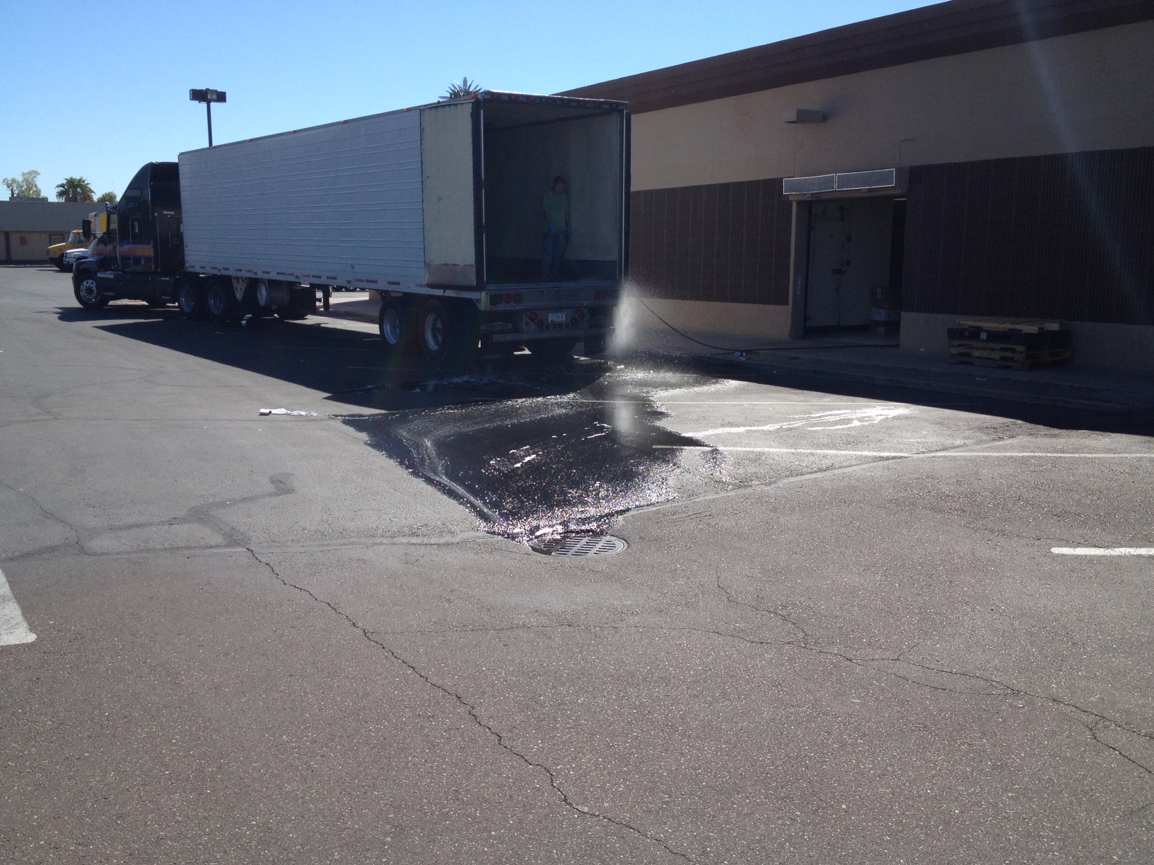
Today’s Agenda:
What is the “MSGP”
Legal / program updates
Changes to 2019 permit
myDEQ
Schedule

Slide 3
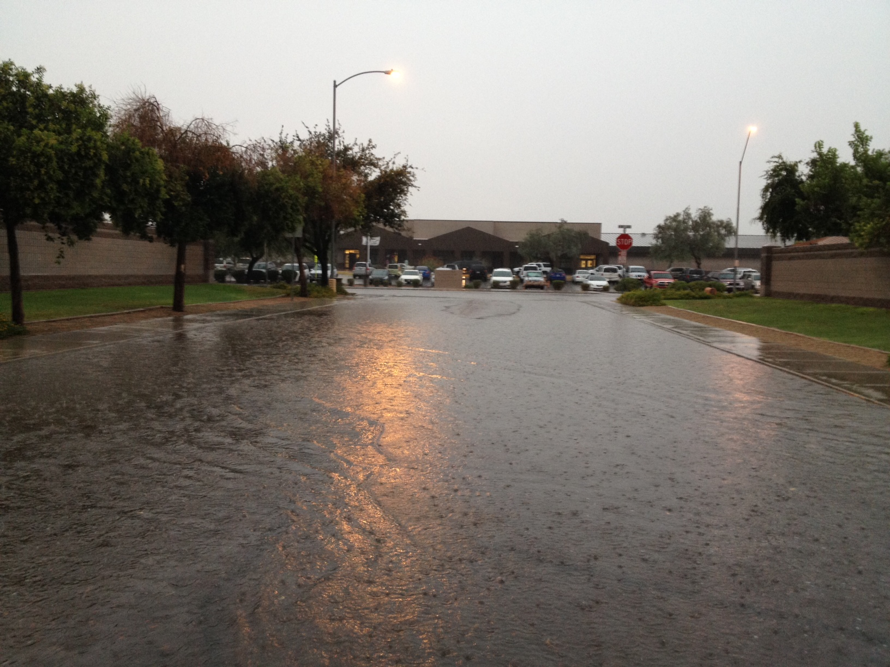
The Clean Water Act (Section 402)
establishes the:
National
Pollutant
Discharge
Elimination
System
In Arizona, we call it AZPDES

Slide 4
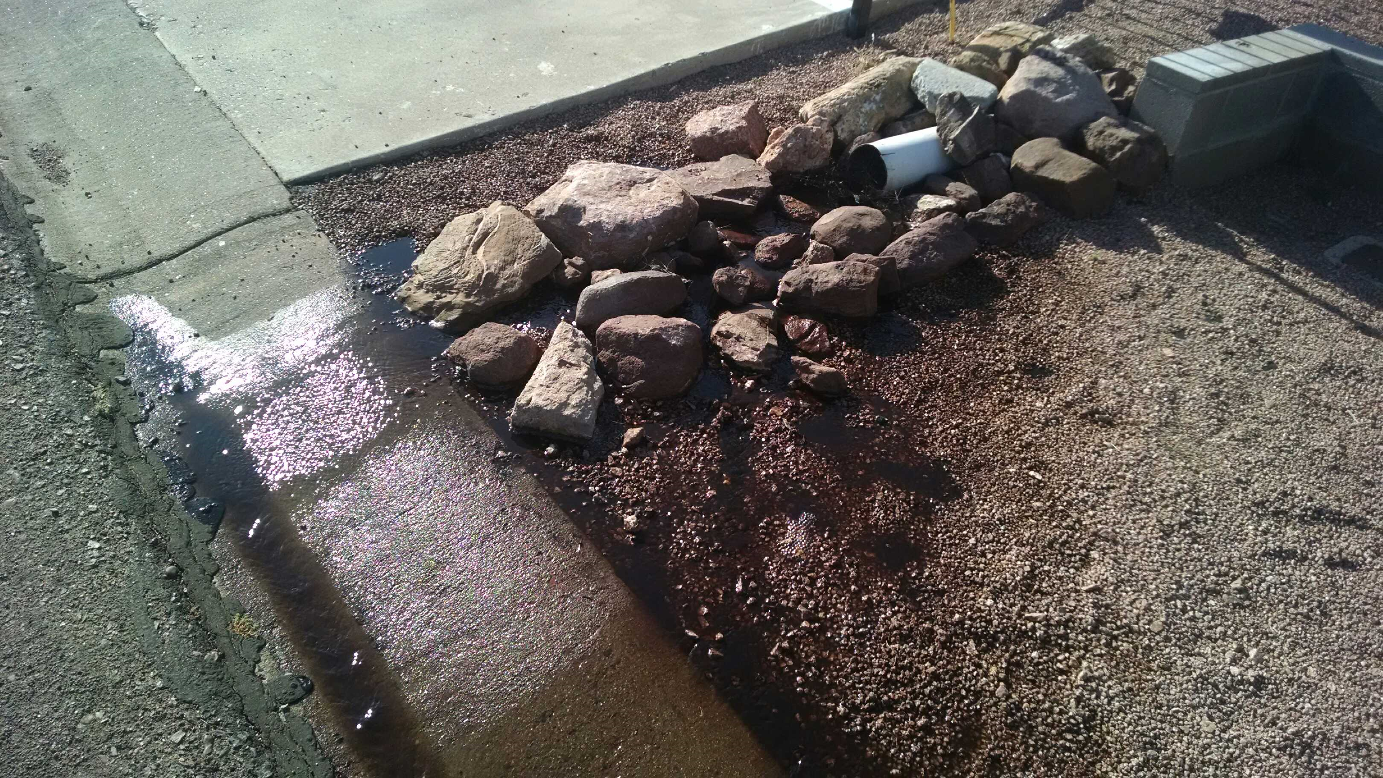
Early NPDES permits focused primarily on Wastewater Treatment Plants
CWA was amended in 1987 to include stormwater:
Municipal
Construction
Industrial

Slide 5
NPDES Stormwater Program Regulates
Industrial
MS4
Construction

Slide 6
Industrial Stormwater Covers 11 Categories
Facilities Subject to Standards
Heavy Manufacturing
Mining / Oil and Gas
Hazardous Waste Facilities
Landfills
Recycling Facilites
Steam Electric Power Plants
Transportation Industries
Sewage Treatment Plants
Large Construction
Light Industry

Slide 7
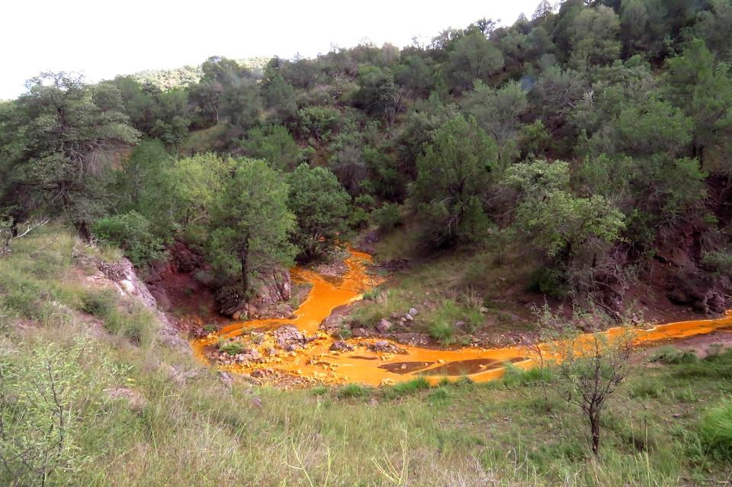
The 11 categories are further broken down by
Sector
Subsector, and
Standard Industrial Classification (SIC) Code.

Slide 8
Reporting
2010 Permit
2019 Permit
All permittees had to prepare and annual report
Some permittees had to submit the annual report to ADEQ
No Annual Report requirement
Prepare and submit a Control Measure Assessment Report (CMAR) when an Action Level is exceeded (Part
Prepare and submit a Corrective Action Report (CAR), when a corrective action triggered (Part

Slide 9
Analytical Monitoring
2010 Permit
2019 Permit
Benchmark monitoring 4X’s/yr with potential to discontinue
Averaging sample results
Benchmark concentrations set at U.S. EPA Water Quality Criteria
Included various analytical parameters that do not have a standard
Routine Analytical Monitoring 2x’s/yr for duration of permit coverage
Report discrete results
Incorporates Arizona Surface Water Quality Standards (SWQS) as Action Levels
Added, removed, or substituted various parameters
Applies SWQS for designated use of the receiving water

Slide 10
Discharge Monitoring Report
2010 Permit
2019 Permit
Report monitoring results within 3 months of end of monitoring period (up to 15 months from when the sample was collected
Use hardness table for hardness dependent metals
Submit eDMR within 30 days of receiving results
Enter hardness value (eDMR will automatically calculate concentration for hardness dependent metals)

Slide 11
Stormwater Pollution Prevention Plan
2010 Permit
2019 Permit
32 business days for ADEQ review (40 +/- days)
Submit SWPPP for sites within 2.5 miles of impaired water or Outstand Arizona Water, regardless of pollutant
Reduced to 30 calendar days for ADEQ review (review most often completed within 7 days)
Using myDEQ, filter impairments and industrial activities to reduce SWPPP submissions when the facility is unlikely to contribute additional pollutant loading for the impaired water

Slide 12
MSGP 2019 Implementation Schedule
Issued May, 2019
Becomes effective January 1, 2020
Existing permittees must submit a Notice of Intent (NOI) to obtain coverage under MSGP 2019 between:
January 1, 2020 and February 28, 2020

Slide 13
NOI Must be Submitted Electronically Using myDEQ
Establish myDEQ account if not already completed
Complete each screen with complete and accurate information
Authorization is issued upon completing the NOI path (including the fee component)

Slide 14
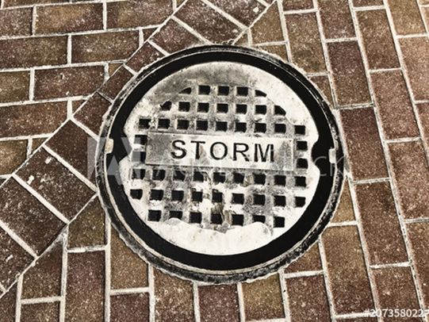
Benefits of E-Notice of Intent (NOI):
Completeness (mandatory fields)
Business rules to lead customer to permitting requirements (poka-yoke)
Built in tools for more accurate information

Slide 15
Mapping Tool to Assist Customers with
Accurately Locating their Site

Slide 16
Example from Industrial Stormwater Permitting Path to Identify Sector(s)

Slide 17
Interactive Mapping Tool to Assist with
Identifying Outfall Location(s)

Slide 18
Outfall Summary Table

Slide 19
Monitoring Requirements Generated
Based on Customer Input

Slide 20
Customer’s Dashboard to Manage Permit Actions

Slide 21
Questions
Contact
Christopher M. Henninger, Supervisor
Surface Water Permits Unit
Arizona Department of Environmental Quality
602-771-4508
Henninger.Christopher@azdeq.gov

Slide 22
Table Slide
Title 1 | Title 2 | Title 3 |  | Title 4 |  | Title 5
 |  | Subtitle 1 | Subtitle 2 | Subtitle 3 | Subtitle 4
Content 1a
Content 1b
Content 1c
Content 1d
Content 1e
Content 1f
Content 1g
Content 1h

